Slide 1

Physical Activity and the Development and Maintenance of Health and Wellbeing
Week 2

Slide 2
This session will cover
The role of PIA in the development of ill-health
The role of PA in the development of health and wellbeing
The role of PA in the prevention of chronic disease
The contribution that sedentary behaviour makes to chronic disease
This is the evidence base

Slide 3
Supportive reading
Ding, D., Lawson, K.D., Kolbe-Alexander, T.L., Finkelstein, E.A., Katzmarzyk, P.T., Mechelen, W.V. and Pratt, M. (2016) The economic burden of physical inactivity: a global analysis of major non-communicable diseases. Lancet; 388,1311-24. (Available on BB).
Bouchard, C., Blair, S.N. and Haskell, W.L. (2012) Physical Activity and Health. 2nd ed. Champaigne, Illinois, Human Kinetics.
Hardman, A.E. and Stensel, D. (2009) Physical Activity and Health: The evidence explained, London, Routledge. Chapters 3 – 9.
Nunan, D., Mahtani, K.R., Roberts, N. and Heneghan, C. (2013). Physical activity for the prevention and treatment of major chronic disease: an overview of systematic reviews. Systematic Reviews, 2:56. (Available on BB)
Library search
Detailed reference list at end of slides

Slide 4
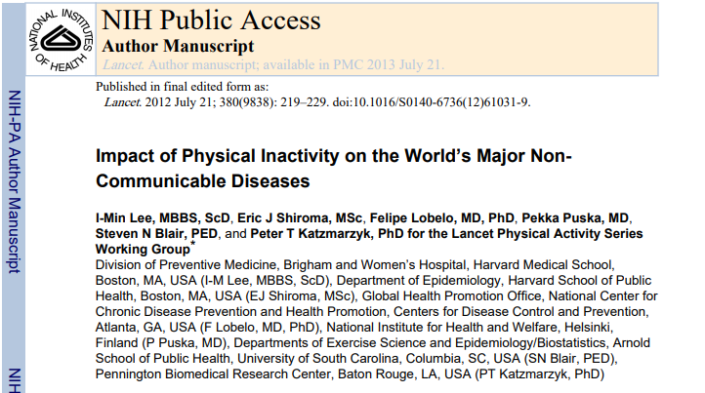
Useful for your essay…(on Blackboard)
Conclusion:
Physical inactivity has a major health impact on the world.
Elimination of physical inactivity would remove between 6% and 10% of the major NCDs of CHD, type 2 diabetes, and breast and colon cancers, and increase life expectancy.

Slide 5
NCD’s attributable to physical inactivity in the UK
Coronary heart disease
Colon cancer
Breast cancer
Type II diabetes
Premature all-cause mortality
(Lee et al., 2012)

Slide 6

Role of PIA in chronic diseases
PIA is an actual cause of over 35 chronic diseases/conditions
Epidemiological studies suggest PIA group prevalence often 30-50% higher for major causes of death
E.g., CVD, Type-2 diabetes, Alzheimer’s
PIA therefore suggested to be an actual cause of shorter healthy lifespan and early mortality
May be due to PIA increasing the decline in vO₂ max, skeletal muscle mass & strength, and cognition
Booth et al. (2017)

Slide 7
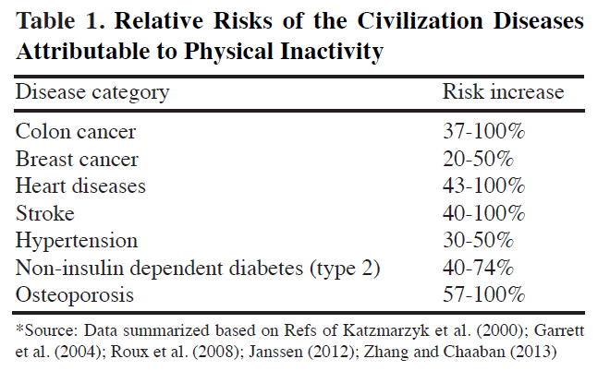
Relative risk of disease attributable to PIA (Kruk, 2014)

Slide 8
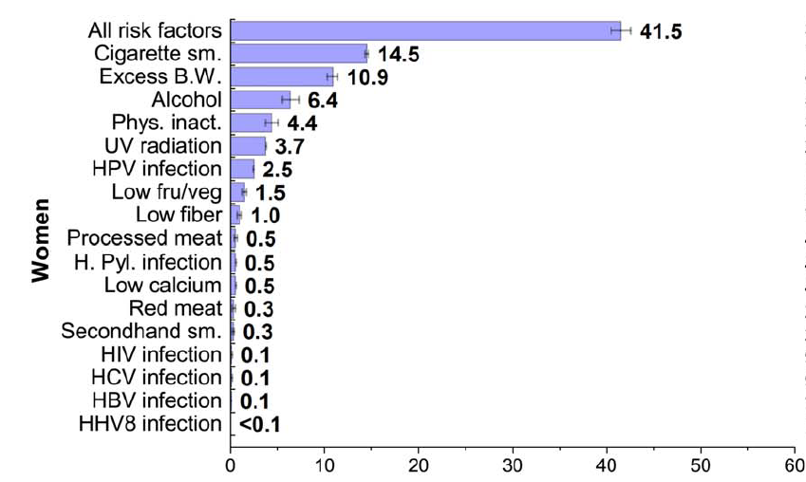
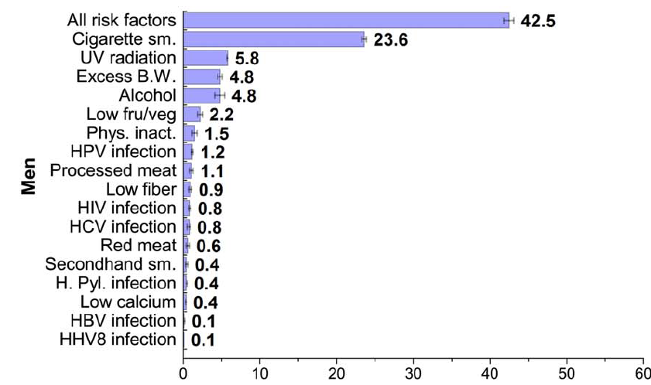
PIA as a cancer risk factor (Islami et al., 2018)
Uterine cancers
Colorectal cancers
Female breast cancers –
Postmenopausal cancers inversely related to all PA
Premenopausal cancers inversely related to vigorous PA only
Proportion of cancer cases attributable to physical inactivity are higher for women than men

Slide 9
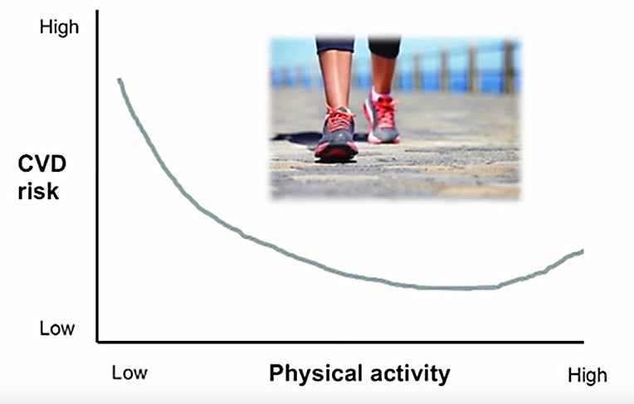
Physical Inactivity and CVD

Slide 10
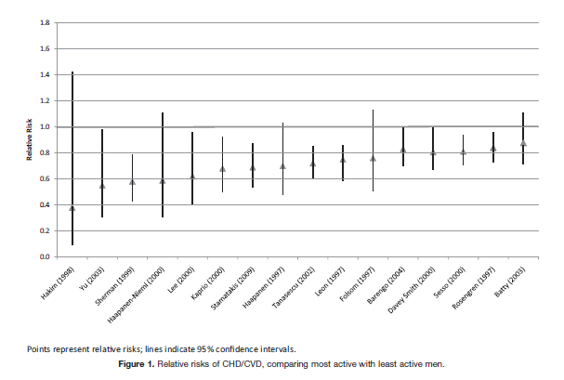
CHD/CVD risk and PIA – Shiroma and Lee (2010) on Blackboard

Slide 11
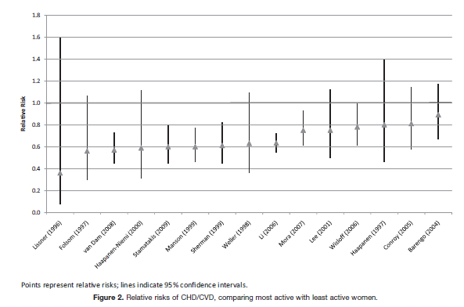
CHD/CVD risk and PIA – Shiroma and Lee (2010) on Blackboard

Slide 12
Economic (global) cost of PIA
Cost to international health care systems
PIA related deaths cost to productivity
Total costs (direct and indirect) UK
Total costs (direct and indirect) USA
(Ding et al., 2016)
Notes:
Healthcare and economical costs

Slide 13
Economic (healthcare) cost of PIA
Coronary heart disease
Stroke
Colorectal cancer
Breast cancer
Type II diabetes
(Scarborough et al., 2011)
Notes:
Healthcare and economical costs

Slide 14


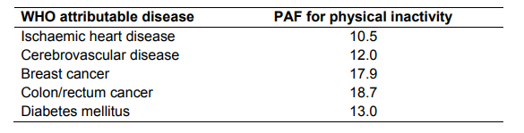
Public Health England, 2016
Notes:
Healthcare and economical costs

Slide 15
Benefits of regular PA
Increase
Decrease
vO₂ max
Stroke volume
Cardiovascular system efficiency
O₂ extraction from arteries
Capillary density
HDL (good) cholesterol
Functional capacity
Blood glucose metabolism
Bone density
Angina threshold
Cognitive function
Blood pressure (at rest and during activity)
Resting heart rate
Heart rate for a given activity
Angina symptoms
Arrythmias
LDL (bad) cholesterol
Arterial plaque deposits
Falls risk
Stress levels
Depression
Body fat percentage
see any good physiology text, e.g., McArdle, Katch and Katch (2015)

Slide 16
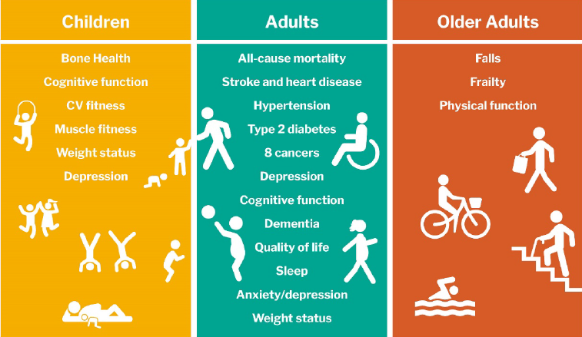
Evidence for health benefit of PA
UK CMO PA Guidelines (Dept Health & Social Care, 2019)

Slide 17
Saving lives with current PA prevalence
Much research looks at the negative narrative, i.e., how many deaths are caused by PIA or how much extra PA is needed to improve mortality rates
Strain et al. (2020), looked at the positive impact that current levels of PA have by estimating how many lives are being saved
Globally, they estimated that current PA levels avert 3.9 million premature deaths
Suggestion that current investments and services have value and therefore should receive continued political support

Slide 18
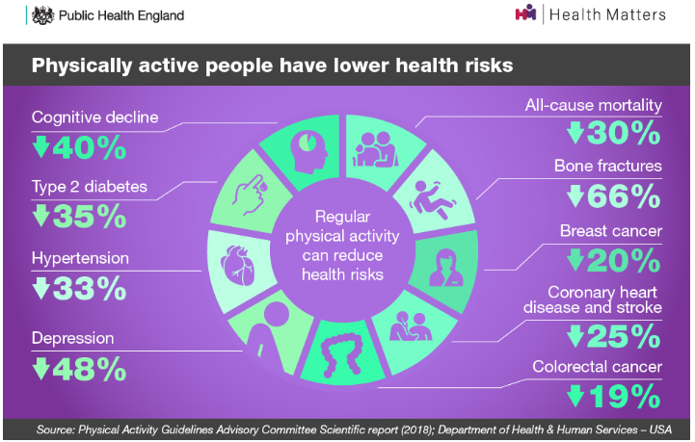

Slide 19
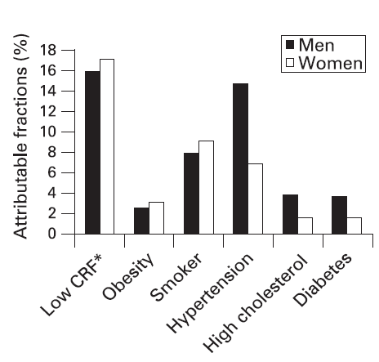
Physical activity as preventative therapy
Low cardiorespiratory fitness is one of the most powerful predictors of health outcomes (Blair, 2009)
Low cardiorespiratory fitness = higher mortality than smoking, alcohol and diabetes combined (Blair, 2009)
Physically active individuals take fewer sick days (Losina et al., 2017)

Slide 20
Irrefutable Evidence for PA in the Primary and Secondary Prevention of:
Diabetes mellitus
Cancer (breast and colon)
Hypertension
Depression
Osteoporosis
Dementia
Cardiovascular disease
All-cause mortality
Bouchard et al. (2012)

Slide 21
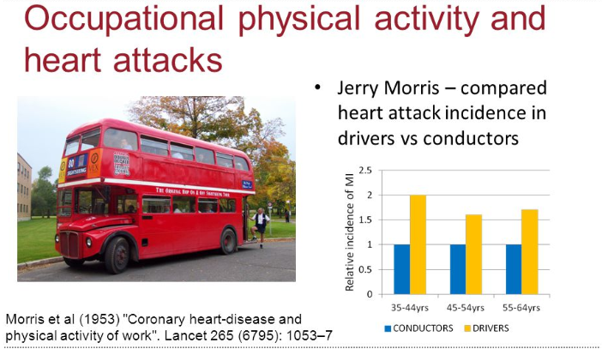
Evidence of PA impact & heart disease

Slide 22
US Railroad Workers Study (longevity) (Taylor et al., 1969)
Natural experiment – acknowledged that is it not feasible to control PA levels in population and measure heart attack rates
Cohort study documenting coronary heart disease (CHD) amongst different rail occupations with contrasting energy expenditure in their jobs
2,571 males
Over 40 years
21% lower risk of 20-year CHD mortality
Self selection?
Confounders

Slide 23
PA and primary prevention of cancer (Schmid et al., 2014)
Cancer site | Average risk reduction | Level of epidemiological evidence
Colon Breast Endometrial Lung Pancreatic Gastric Prostate Ovarian | 25% 25% 20-30% 20-50% 25% 30% 10% <10% | Convincing Convincing Probable Possible Possible Possible Insufficient Insufficient

Slide 24
Bringing the PA evidence up to date
Cleven et al. (2020)
26 studies published since 2012 where analysed to identify recent trends in the role of PA and disease prevention
Higher levels of PA are likely associated with lower risk of becoming obese, developing CHD and diabetes
Associations reinforce earlier findings suggesting the link is still valid
Link with reduction in hypertension questioned and more research was recommended

Slide 25

CVD Risk Factors

Slide 26
Prevention of CVD – How?
Reduces high BP (Myers et al., 2015; Warburton et al, 2010)
Increases HDL (‘good’ cholesterol)
Decreases LDL (‘bad’ cholesterol) (Kelley et al, 2011)
Reduces obesity (Myers et al., 2015)
Prevents Type II diabetes (Lee et al, 2012)
Helps to reduce the effects of stress (Myers et al., 2015)

Slide 27
Sitting…
‘any waking behaviour characterised by an energy expenditure ≤1.5 METs while in a sitting, reclining or lying posture’
Tremblay et al., for the Sedentary Behaviour Research Network (2017)

Slide 28
Sedentary behaviour and PA guidelines
Current guidelines not just about how much PA but avoiding sitting still
i.e., sedentary behaviour
However, no current specific time limit or minimum threshold stated
“Adults should aim to minimise the amount of time spent being sedentary, and when physically possible should break up long periods of inactivity with at least light physical activity.”
UK CMO PA Guidelines (DHSC, 2019)

Slide 29
What does the evidence suggest?
Sitting for more than 4 hours a day leads to…
Reduced calorie burning (metabolic rate) (Buman et al., 2014)
Disrupted blood sugar levels (Thorp et al., 2014)
Increased levels of insulin and BP (Dunstan et al., 2012)
The shutting down of enzymes responsible for burning ‘bad’ blood fats (Healy et al., 2011)
Leg muscles switch off (Tikkanen et al., 2013)

Slide 30
What does the evidence suggest?
Larsson and Wolk (2019)
Prolonged sedentary leisure time was associated with:
Increased all-cause mortality
A significantly decreased survival time of up to 2.4 years in middle-aged adults
Association more marked amongst those who also had a sedentary job

Slide 31
What does the evidence suggest?
Ekelund et al. (2020)
Meta-analysis of nine studies looking at SB and mortality
44,370 men and women were followed for 4-14.5 years
3451 participants died during this time (7.8%)
Average sedentary time was 8.5-10.5 hrs/day
Average MVPA (moderate-to-vigorous) 8-35 mins/day
Groups split into lowest, middle and highest thirds of both MVPA and sedentary time
When compared to most active and least sedentary group, risk of death increased with lower MVPA and higher sedentary time
Lowest third MVPA group had higher risk of death with all combinations of sedentary time
30-40 mins of MVPA per day needed to compensate for association between sedentary time and risk of death

Slide 32
What does the evidence suggest?
Rees-Punia et al. (2019)
Examination of replacing 30 mins/day of sitting with equivalent duration of light PA or MVPA
For those with the lowest initial PA levels -
14% mortality risk reduction when light PA incorporated
45% mortality risk reduction when MVPA incorporated
PH recommendation – even modest changes to combat sedentary behaviour can promote significant improvements

Slide 33
The sedentary office – Buckley et al. (2015)
Guidelines for employers and staff working in office environments devised by a panel of experts
Commissioned by PHE
Recommendations developed using the available evidence-base
Predominantly desk-based worker should aim to:
Progress towards accumulating at least 2 hrs/day of standing/light activity
Eventually aim for 4 hrs/day
Break up seated-based work with standing-based work – sit-stand stations recommended
Also avoid prolonged static standing – MSK issues

Slide 34
Stand More at Work (SMArT) intervention– Edwardson et al. (2018)
Conducted within a NHS trust, height adjustable desks were used in conjunction with advice and coaching sessions to study whether there was an impact on sitting time
In comparison to the control group (no intervention), sitting time was reduced at the 3, 6 & 12 month intervals
Improvements were also noted in standing time, job performance, work engagement, occupational fatigue, sickness presenteeism, daily anxiety and quality of life

Slide 35
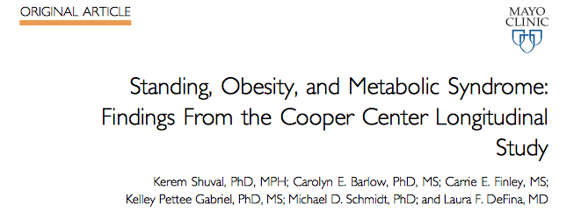
7075 adults aged 20-79
Association between reported standing time and BMI, waist circumference, body fat % and metabolic syndrome
Conclusion: standing time was related (inversely) to obesity

Slide 36
Directed study
Record your physical activity
Record your own physical activity levels over the next 7 days and bring to the seminar
This should include the time you spend sitting daily
Be prepared to share your methods of recording your activity
Identify any challenges that you experienced when recording your activity

Slide 37
Directed study
Have a look at the latest UK Physical Activity Guidelines and identify the recommendations for
Under 5s
Children and Young People
Adults
Older Adults

Slide 38
References
Blair, S.N. (2009). Physical inactivity: the biggest public health problem of the 21st century. British Journal of Sports of Sports Medicine 43(1):1-3.
Booth, F., Roberts, C., Thyfault, J., Ruegsegger, G. and Toedebusch, R. (2017) The role of inactivity in chronic diseases: evolutionary insight and pathophysiological mechanisms, Physiology Review, 97, 1351-1402
Bourke, L., Doll, H., Crank, H., Daley, A., Rosario, D.J., Saxton, J.M. (2011). Lifestyle intervention in men with advanced prostate cancer receiving androgen suppression therapy: a feasibility study. Cancer Epidemiology, Biomarkers and Prevention. 20(4):647-57.
Buckley, J.P., Hedge, A., Yates, T., Copeland, R.J., Loosemore, M., Hamer, M., Bradley, G. and Dunstan, D.W. (2015). The sedentary office: an expert statement on the growing case for change towards better health and productivity. British Journal of Sports Medicine; 49:1357-1362.
Church, T.S., Thomas, D.M., Tudor-Locke, C., Katzmarzyk, P.T., Earnest, C.P., Rodarte, R.Q., Martin, C.K., Blair, S.N., Bouchard, C. (2011). Trends over 5 Decades in U.S. Occupation-Related Physical Activity and Their Associations with Obesity. PLoS One; 6(5).
Clark et al. (2005). Meta-Analysis: Secondary Prevention Programs for Patients with Coronary Artery Disease. Annals of Internal Medicine ; 143(9): 659-672.
Cleven, L., Krell-Roesch, J., Nigg, C and Woll, A. (2020) The association between physical activity with incident obesity, coronary heart disease, diabetes and hypertension in adults: a systematic review of longitudinal studies published after 2012, BioMed Central Public Health, 20, 726
Edwardson, C. et al. (2018) Effectiveness of the SMART work intervention: cluster randomised controlled trial, British Medical Journal, 363, k3870

Slide 39
References
Ekelund et al. (2020) Joint associations of accelerometer-measured physical activity and sedentary time with all-cause mortality: a harmonised meta-analysis in more than 44,000 middle-aged and older individuals, British Journal of Sports Medicine, 54, 1499-1507.
Heran et al. (2011). Exercise-based cardiac rehabilitation for coronary heart disease. Cochrane Database of Systematic Reviews , Issue 7. Art. No: CD001800. DOI: 10.1002/14651858.CD001800.pub2.
Islami, F., Goding Sauer, A., Miller, K.D., Siegel, R.L., Fedewa, S.A., Jacobs, E.J., McCullough, M.L., Patel, A.V., Ma, J., Soerjomafaram, I., Flanders, W.D., Brawley, O.W., Gapstur, S.M. and Jemal, A. (2018). Proportion and number of cancer cases and deaths attributable to potentially modifiable risk factors in the United States. CA: A Cancer Journal for Clinicians; https://doi.org/10.3322/caac.21440
Kelley, G.A., Kelley, K.S., Roberts, S. and Haskell, W. (2011). Efficacy of aerobic exercise and a prudent diet for improving selected lipids and lipoproteins in adults: a meta-analysis of randomized controlled trials. BMC Medicine 9(74)
Khan, K.M. and Davis, J. C. (2010). A week of physical inactivity has similar health costs to smoking a packet of cigarettes. British Journal of Sports Medicine; 44:395.
Larson, S. and Wolk, A. (2019) Sedentary leisure-time in relation to mortality and survival time, Journal of Science and Medicine in Sport, 22, 562-567

Slide 40
References
Lawler et al. (2011). Efficacy of exercise-based cardiac rehabilitation post-myocardial infarction: A systematic review and meta-analysis of randomized controlled trials. American Heart Journal; 162: 571-584.
Lee, I., Shiroma, E.J., Lobelo, F., Puska, P., Blair, S.N., Katzmarzyk, P.T., for the Lancet Physical Activity Series Working Group (2012). Effect of physical inactivity on major non-communicable diseases worldwide: An analysis of burden of disease and life expectancy. The Lancet;380(9838):219-229.
Losina, E., Yang, H., Deshpande, B.R., Katz, J.N. and Collins, J.E. (2017). Physical activity and unplanned illness-related work absenteeism: Data from an employee wellness program. PLoS One; 12(5): e0176872
Myers., J., McAuley, P., Lavie, C.J., Despres, J-P., Arena, R. and Kokkinos, P. (2015). Physical Activity and Cardiorespiratory Fitness as MajorMarkers of Cardiovascular Risk: Their Independent and Interwoven Importance to Health Status. Progress in Cardiovascular Diseases; 306-314
Paffenbarger, R.S., Hyde, P.H., Wing, A.L. and Hsieh, C.C. (1986). Physical Activity, All-Cause Mortality and Longevity of College Alumni. The New England Journal of Medicine;314(10):605.
Rees-Penia, E., Evans, E., Schmidt, M., Gay, J., Matthews, C., Gapstur, S. and Patel, A. (2019) Mortality risk reductions for replacing sedentary time with physical activities, American Journal of Preventative Medicine, 1-6

Slide 41
References
Scarborough, P., Bhatnagar, P., Wickramasinghe, K.K, Allender, S., Foster, C., Rayner, M. (2011) The economic burden of ill health due to diet, physical inactivity, smoking, alcohol and obesity in the UK: An update to 2006-2007 NHS costs. Journal of Public Health;33(4):527-535.
Schmid, D., Steindorf, K., Leitzmann, M.F. (2014). Epidemiologic studies of physical activity and primary prevention of cancer. Deutsch Zeitschrift Fur Sportmedizin: 65; 5-10.
Scott, E., Daley, A.J., Doll, H., Woodroofe, N., Coleman, R.E., Mutrie, N., Crank, H., Powers, H.J., Saxton, J.M. (2013). Cancer Causes and Control; 24; 181-191.
Shiroma, E. and Lee, I. (2010) Physical activity and cardiovascular health. Lessons learned form epidemiological studies across age, gender, and race/ethnicity. Circulation, 122; 743-752
Strain, T., Brage, S., Sharp, S., Richards, J., Tainio, M., Ding, D., Benichou, J. and Kelly, P. (2020) Use of the prevented fraction for the population to determine deaths averted by existing prevalence of physical activity: a descriptive study. The Lancet Global Health, 8, e920-930
Taylor et al. (2004). Exercise-based rehabilitation for patients with coronary heart disease: systematic review and meta-analysis of randomized controlled trials. American Journal of Medicine; 116(10):682-697.
Tremblay, M., Aubert, S., Barnes, J.D., Saunders, T.J., Carson, V., Latimer-Cheung, A.E., Chastin, S.F.M., Altenbury, T.M., and Chinapaw, M.J.M. (2017). Sedentary Behavior Research Network (SBRN) – Terminology Consensus Project process and outcome. International Journal of Behavioral Nutrition and Physical Activity; 14:75.
Warburton DE, Charlesworth S, Ivey A, Nettlefold L, Bredin SS. (2010). A systematic review of the evidence for Canada’s physical activity guidelines for adults. International Journal of Behavioural Nutrition and Physical Activity;7(39).

